Slide 1
Machine learning–based intelligent traffic congestion prediction and optimisation using real-time urban mobility and sensor data
Student Name: Anil Kumar Chava
Student ID: 24068000
Supervisor Name: Pushp Raj Tiwari
Notes:
The dataset used in this implementation is obtained from the Zenodo repository using record ID 3939793. It contains California traffic data collected from PeMS sensors. The dataset was downloaded as a compressed file of approximately 606MB and extracted into three large CSV files totaling around 4.1GB. These files represent traffic data collected over four, eight, and twelve weeks. Each file contains speed readings recorded at five-minute intervals across multiple sensors. The data was processed by computing average speed per time step and merging all files into a unified time-series dataset indexed by timestamp.

Slide 2
Introduction
Rapid urbanisation increases vehicles, causing severe traffic congestion issues
Traffic congestion increases travel time, fuel consumption, and pollution
Traditional traffic systems fail to handle dynamic real-time conditions
Availability of urban mobility and sensor data enables smarter solutions
Machine learning identifies complex spatiotemporal traffic patterns effectively
Intelligent transportation systems improve decision-making and traffic flow management
Study focuses on prediction and optimisation using real-time traffic data
Notes:
Traffic congestion has become a major issue due to rapid urbanisation and increasing vehicle numbers. It affects travel time, fuel usage, and environmental conditions. Traditional traffic management systems depend on fixed rules and historical data, making them less effective in handling dynamic traffic situations. With the growth of real-time sensor data and urban mobility datasets, there is an opportunity to apply machine learning techniques for better prediction. Machine learning helps analyse complex traffic patterns over time and space. This research focuses on developing intelligent models that can predict congestion and support optimisation strategies to improve traffic flow and enhance overall transportation system efficiency.

Slide 3
Research Aim and Objectives
Research Aim
The purpose of the research is to design and test the machine learning models on the predicted and optimized real-time traffic congestion based on the data of urban mobility and sensors, to enhance the efficiency of traffic flows, to decrease the delays caused by congestion, and to make decisions for the intelligent transportation system.
Research Objectives
To collect, preprocess, and combine real-time urban mobility and traffic sensor data in machine learning-based congestion analysis.
The aim of the study is to come up with a spatiotemporal machine learning model to predict both short-term and long-term traffic congestion accurately.
To test how best to optimize strategies based on model prediction to increase the efficiency of the use of traffic signals and the use of routes.
To measure model performance based on the accuracy of the predictions made by the model, the RMSE, MAE, and the congestion detection reliability metrics.
To evaluate model scalability and strength in various urban areas and at divergent patterns of traffic demand.
Notes:
The main aim of this research is to design and test machine learning models for predicting and optimising traffic congestion using real-time data. The study focuses on improving traffic flow and reducing delays. To achieve this, data from urban mobility and traffic sensors is collected and preprocessed. Spatiotemporal models are developed to capture traffic patterns over time and space. The research also explores optimisation strategies such as traffic signal control and route planning. Model performance is evaluated using standard metrics like accuracy, RMSE, and MAE. Additionally, the study examines how well the models perform across different traffic scenarios and urban environments.

Slide 4
Research Question and Rational
Research Question
What are the most appropriate spatiotemporal attributes that can be utilized to provide faithful predictive traffic congestion utilizing real-time machine learning models?
To what extent can machine learning models be used to predict traffic congestion in dynamic and heterogeneous urban traffic scenarios?
Which ways can machine learning predictions help in traffic optimization schemes in intelligent transportation systems?
Research Rational
Traditional systems lack adaptability to changing real-time traffic conditions
Real-time datasets enable more accurate and intelligent traffic prediction
Machine learning improves decision-making in intelligent transportation systems
Research supports sustainable urban mobility and efficient traffic management
Notes:
This research is guided by key questions related to traffic prediction and optimisation. It aims to identify important spatiotemporal features that influence congestion. Another focus is to evaluate how effective machine learning models are in handling dynamic and complex traffic scenarios. The study also examines how predictions can be used to improve traffic optimisation strategies. The rationale behind this research is that traditional systems are not flexible enough for real-time conditions. With access to real-time datasets, machine learning can provide more accurate insights. This helps improve decision-making in intelligent transportation systems and contributes to sustainable and efficient urban mobility solutions.

Slide 5
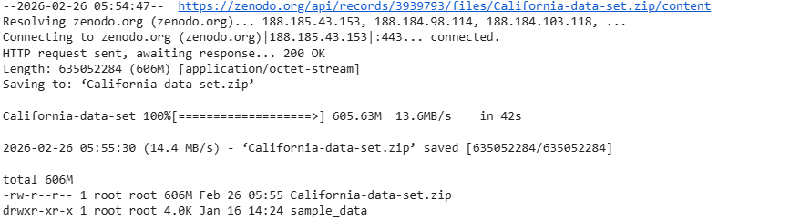
Dataset Overview
Dataset sourced from Zenodo (Record ID: 3939793)
California Traffic Dataset (PeMS sensors)
Downloaded file: California-data-set.zip (~606MB)
Extracted size: ~4.1GB with 3 CSV files
Files: pems-4w.csv, pems-8w.csv, pems-12w.csv
Traffic speed recorded every 5 minutes
Final dataset: time-series average speed with timestamp index
Notes:
The dataset used in this implementation is obtained from the Zenodo repository using record ID 3939793. It contains California traffic data collected from PeMS sensors. The dataset was downloaded as a compressed file of approximately 606MB and extracted into three large CSV files totaling around 4.1GB. These files represent traffic data collected over four, eight, and twelve weeks. Each file contains speed readings recorded at five-minute intervals across multiple sensors. The data was processed by computing average speed per time step and merging all files into a unified time-series dataset indexed by timestamp.

Slide 6
Methodology
Dataset downloaded using Zenodo API
Extracted and processed multiple large CSV files
Computed average traffic speed per time step
Merged all datasets into single time-series
Performed exploratory data analysis (EDA)
Developed regression-based prediction models
Implemented traffic optimisation strategies
Notes:
The methodology begins with downloading the dataset using the Zenodo API and extracting the compressed files. Each CSV file is processed individually by computing the average traffic speed across all sensors for every time step. These individual time-series are then merged into a single continuous dataset. Exploratory Data Analysis is performed to understand speed distribution, temporal patterns, and congestion behavior. Multiple regression models are developed to predict traffic speed. Finally, optimisation strategies such as adaptive signal control and rerouting are applied based on predicted congestion conditions to improve traffic flow.

Slide 7
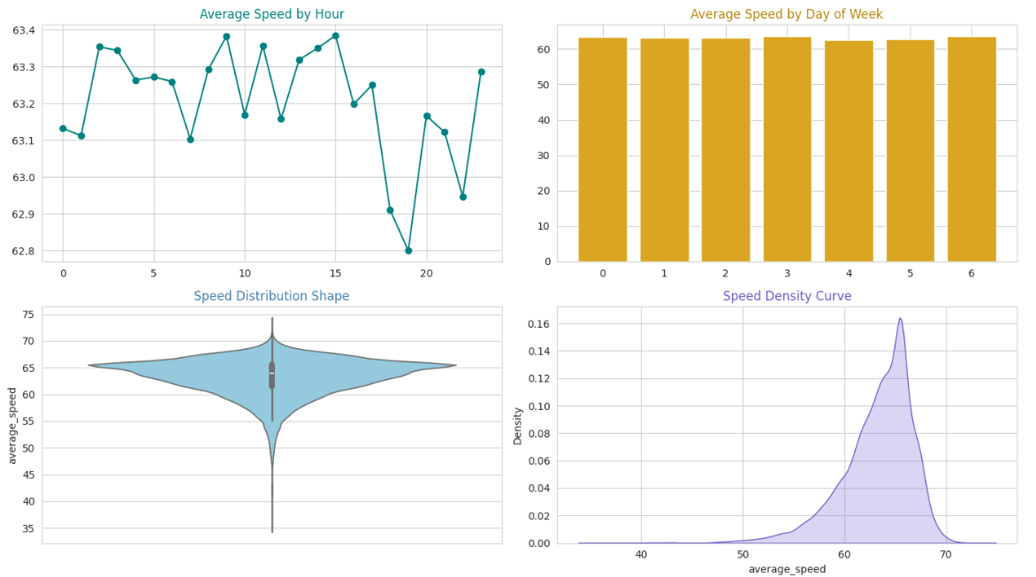
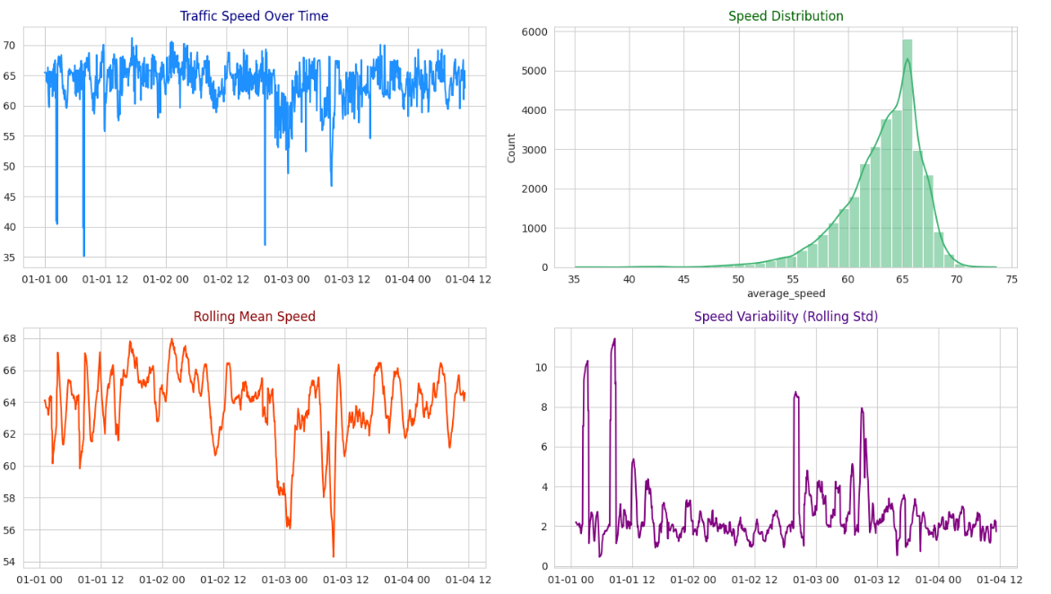
Data Preprocessing
Created timestamp index with 5-minute intervals
Generated features: hour, day_of_week
Added peak hour and weekend indicators
Applied cyclical encoding (hour_sin, hour_cos)
Created lag features: lag_1, lag_3, lag_6
Computed rolling mean (30-minute window)
Split dataset into 80% training and 20% testing
Notes:
Data preprocessing involves transforming raw traffic data into a structured format suitable for modeling. A timestamp index with five-minute intervals is created to represent the time series. Time-based features such as hour and day of the week are generated along with indicators for peak hours and weekends. Cyclical encoding using sine and cosine functions is applied to capture periodic patterns. Lag features are introduced to represent temporal dependencies in traffic flow. A rolling mean over a thirty-minute window is computed to smooth variations. Finally, the dataset is split into training and testing sets using a time-based approach.

Slide 8
Model Development
Applied feature scaling using StandardScaler
Trained Linear Regression model
Implemented Support Vector Regression (SVR)
Used Random Forest Regressor (Ensemble model)
Applied Gradient Boosting Regressor
Developed LSTM and GRU deep learning models
Compared ML and DL model performance
Notes:
Model development includes training multiple machine learning and deep learning models for traffic speed prediction. Feature scaling is applied using StandardScaler to normalize input variables. Linear Regression and Support Vector Regression are used as baseline models. Ensemble methods such as Random Forest and Gradient Boosting are implemented to improve predictive accuracy. Deep learning models including LSTM and GRU are developed to capture temporal dependencies in the data. All models are trained using the same dataset and evaluated using consistent performance metrics to ensure fair comparison and selection of the best-performing model.

Slide 9
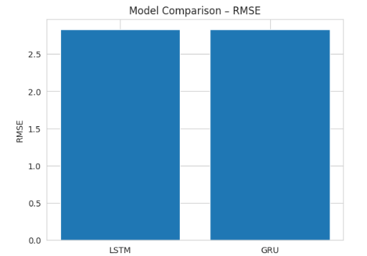
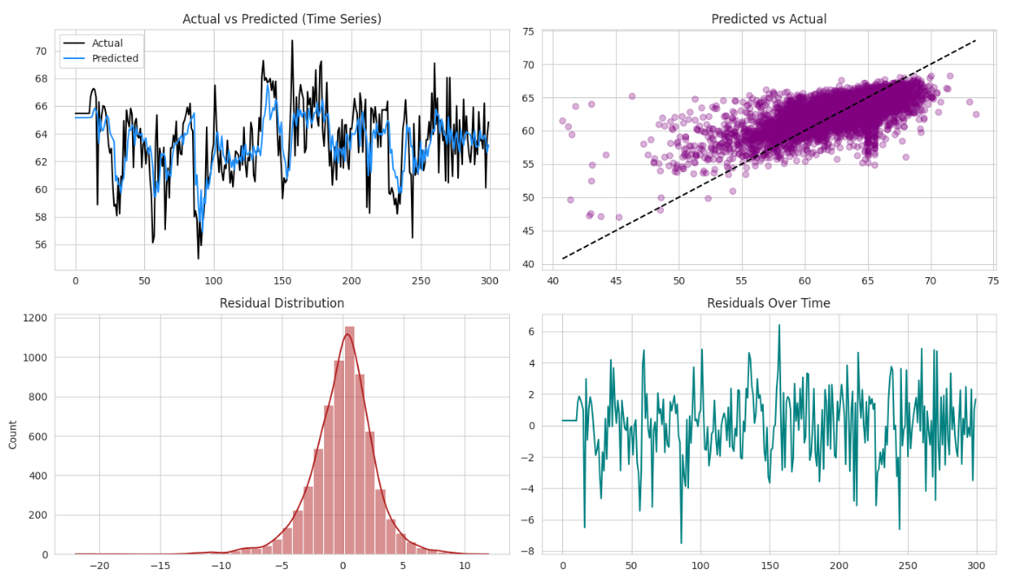
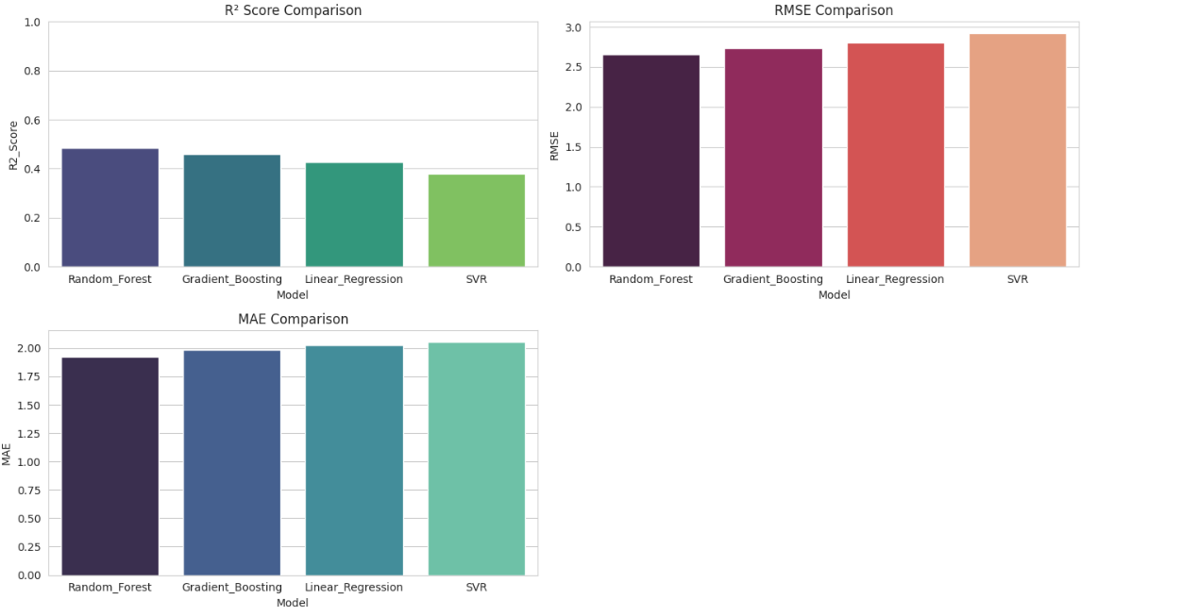
Evaluation & Results
Random Forest → R²: 0.486, RMSE: 2.659, MAE: 1.922
Gradient Boosting → R²: 0.458, RMSE: 2.731, MAE: 1.982
Linear Regression → R²: 0.427, RMSE: 2.808, MAE: 2.029
SVR → R²: 0.380, RMSE: 2.921, MAE: 2.057
Best Model: Random Forest
LSTM R²: 0.418, GRU R²: 0.419
Optimization improved average traffic speed
Notes:
Model evaluation is performed using R-squared, RMSE, and MAE metrics. Among all models, Random Forest achieved the best performance with an R-squared value of 0.486, RMSE of 2.659, and MAE of 1.922. Gradient Boosting, Linear Regression, and SVR showed comparatively lower performance. Deep learning models such as LSTM and GRU achieved R-squared values of approximately 0.418 and 0.419 respectively, indicating moderate performance. Based on these results, Random Forest is selected as the best-performing model. Additionally, optimisation strategies applied on predicted traffic conditions resulted in an improvement in overall traffic speed.

Slide 10
Conclusion
Random Forest achieved highest performance among all tested models
Model achieved R² score of 0.486 with lowest errors
Gradient Boosting and Linear Regression showed moderate prediction performance
SVR model performed lower compared to other machine learning models
Deep learning models LSTM and GRU showed comparable results
Optimisation strategies improved average traffic speed and flow efficiency
Machine learning effectively supports intelligent traffic management systems
Notes:
The results of this study show that the Random Forest model performed best among all models tested, achieving the highest R² score and lowest prediction errors. Other models like Gradient Boosting and Linear Regression showed moderate performance, while Support Vector Regression performed relatively lower. Deep learning models such as LSTM and GRU provided comparable results but did not outperform Random Forest. The implementation of optimisation strategies based on model predictions helped improve average traffic speed and overall traffic flow. These findings highlight that machine learning can effectively support intelligent traffic management systems and provide practical solutions for reducing congestion in urban environments.

